Slide 1


Quantum Key Distribution
QKD enables two parties to share a secret key securely using quantum mechanics.
by Vasundhara Ravi

Slide 2
Our BB84 Simulation Architecture
We designed our BB84 simulation using an object-oriented approach, separating sender and receiver logic for modularity. Noise is applied probabilistically to simulate realistic quantum channels, while eavesdropping is actively modeled to analyze its effect on key security. This setup allows us to measure error rates and determine whether the generated key remains secure under various conditions.

Slide 3
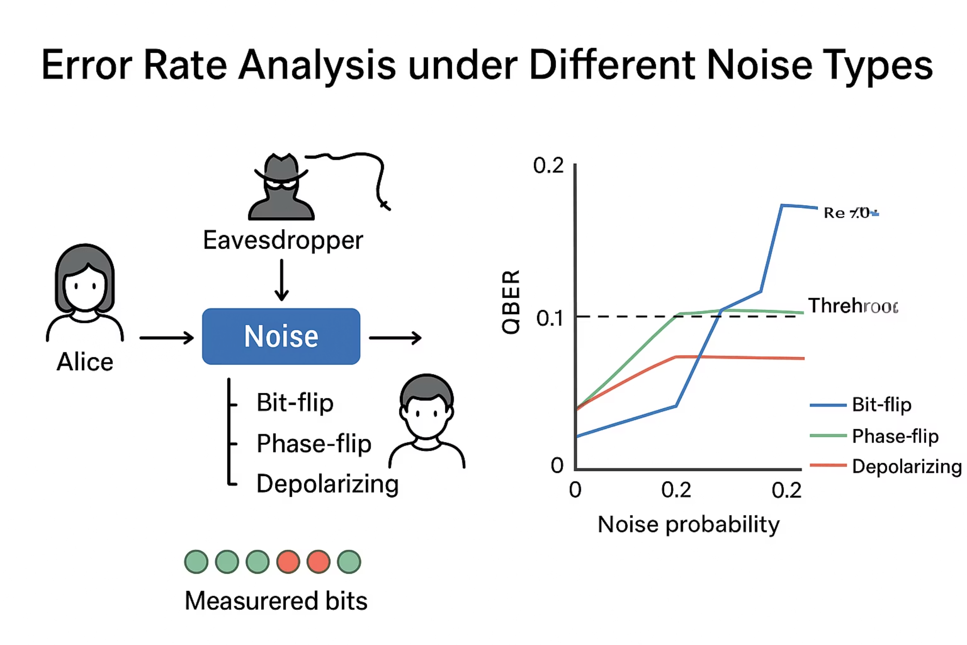
Analysis of the error rate with respect to different types of noise
Different noise types — bit-flip, phase-flip, and depolarizing — are applied probabilistically to simulate realistic channel errors.
By measuring QBER for each noise type, we can determine which keys remain secure (below the error threshold) and detect potential eavesdropping or excessive noise.

Slide 4
Thank you!

